Slide 1
Design and Analysis of Algorithms Quicksort
Notes:
Today’s topic is Quick Sort which is a sorting algorithm. We will discuss Quick Sort Algorithm, then we will perform its Dry Run, then its implementation then its complexity Analysis.

Slide 2
Quicksort Algorithm
Quicksort example
Current pivots
Previous pivots
2
8
7
1
3
5
6
4
Quicksort
2
1
3
4
7
5
6
8
2
1
3
4
7
5
6
8
Nothing 3rd
1
2
3
4
5
6
7
8
1
2
3
4
5
6
7
8
1
2
3
4
5
6
7
8
Notes:
Here is the Dry Run it will make clear understanding of the working of algorithm. It is an in-place algorithm, that means we will be working on the original array and we do not required extra amount of memory to perform this sorting.
In QS we use a deterministic logic that at every recursive call we will select the last index as pivot point, however you can use First Index as pivot point.
So we need to remember the pivot point, the current pivot point is shown with green color, previous with purple color.
It is the original array. We select the last index as pivot point.
Then, values less then pivot point will be arranged before the pivot point and values greater than pivot point will come after the pivot point.
Now assume that we are having two arrays Left and Right. Actually there is only one original but we will partition it in Left and Right array using indexes.
now, select pivot points in both arrays.
We will make recursive call till we reach base case. Means the length of array should be greater then 1.

Slide 3
Quicksort Algorithm
Input: A[1, …, n]
Output: A[1, .., n], where A[1]<=A[2]…<=A[n]
Quicksort:
if(n<=1) return;
Choose the pivot p = A[n]
Put all elements less than p on the left; put all elements lager than p on the right; put p at the middle. (Partition)
Quicksort(the array on the left of p)
Quicksort(the array on the right of p)
Notes:
In algorithm we will give an arrays as input and output will be a sorted array.
At line one we are mentioning the base case that length should be greater then 1.
Now we will select the pivot point.
We will perform some partitioning but putting all elements less than pivot point on the left and all elements lager than pivot point on the right.
Then, we will make recursive calls for Left array(1st partition) and right array (2nd partition).

Slide 4
Quicksort Algorithm
More detail about partition
Input: A[1, …, n] (p=A[n])
Output: A[1,…k-1, k, k+1, … n], where A[1, …, k-1]<A[k] and A[k+1, … n] > A[k], A[k]=p
Partition:
t = the tail of smaller array
from i= 1 to n-1{
if(A[i]<p) {
exchange A[t+1] with A[i];
update t to the new tail;
}
exchange A[t+1] with A[n];
Notes:
This is the partitioning algorithm. We will sort arrange the values in loop using some conditions.

Slide 5
void QuickSort(int arr[],int start, int end)
{
if(start < end)
{
int pindex = Partition(arr, start, end);
QuickSort(arr,start,pindex-1);
QuickSort(arr,pindex+1,end);
}
}
Notes:
There is the code. Start the end are the stating and ending indexes of array.
Then start < end means that length should be greater than 1.
Then partitioning function and two recursive calls.
----------------------
Here is two recursive call and at average case the we assume that two partitions are same.
So, it means we will call two times function T with size of problem (n / 2), due to partitioning.
And case of partition function is n. so, it will become 2T(n/2)+n.

Slide 6
int Partition(int arr[], int start, int end)
{
int pivot = arr[end];
int pindex = start;
for (int i = start; i < end; i++)
{
if(arr[i] <= pivot)
{
swap(arr[i], arr[pindex]);
pindex++;
}
}
swap(arr[pindex], arr[end]);
return pindex;
}
Notes:
Here is the partitioning code. It is quite simple, please perform a dry run to understand the logic.
Now, we will perform the complexity analysis. Partition function is not a recursive function so we will calculate its complexity. Than is O(n) due to its linear loop.

Slide 7
Recurrence Relation
Notes:
Solve this recurrence relation using iteration method.

Slide 8
Analysis of Quicksort
Time complexity
Worst case
Expected
Space complexity - extra memory
0 = O(1)
Notes:
Time complexity will be O(nlogn) and space complexity is constant because it is a in-place algorithm.

Slide 9
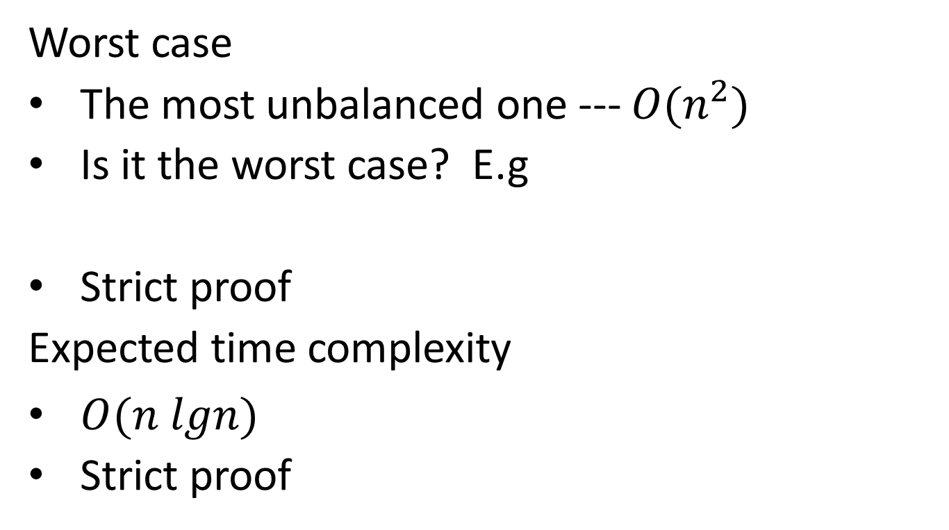
Analysis of Quicksort
Worst case
The most unbalanced one --- $O(n^{2})$
Is it the worst case? E.g
Strict proof
Expected time complexity
$O(n lgn)$
Strict proof
9 | 8 | 7 | 6 | 5 | 4 | 3 | 2
Notes:
In worst case the time complexity will be O( n²).
Lest assume that array is in reverse order then it will not get partitioned in equal halfs, and it will become unbalanced. So its recurrence relation will become n + s(n-1).

Slide 10
Randomized Quick sort:
Select the pivot point randomly from array. It will reduce chances of worst case.
Notes:
To avoid unbalanced partitioning we will use randomized QuickSort. I which we will

Slide 11
Questions?

